Slide 1
Using the Input and Output Devices

Slide 2
Objectives
Introducing the most common Input and output devices
Introducing the devices for the hand
Introducing audiovisual input devices
Details about Monitors
Details about Printers
Ergonomics

Slide 3
The Keyboard
The most common input device
Also called primary input device for entering text and numbers.
A standard keyboard includes about 100 keys, each key sends a different signal to the CPU.
Most be proficient with keyboard
The Skill of typing is called keyboarding means the ability to enter text and number with skill and accuracy.

Slide 4
How keyboard works
Keyboard controller detects a key press
Controller sends a code to the CPU
Code represents the key pressed
Controller notifies the operating system
Operating system responds
Controller repeats the letter if held

Slide 5
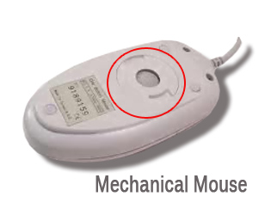
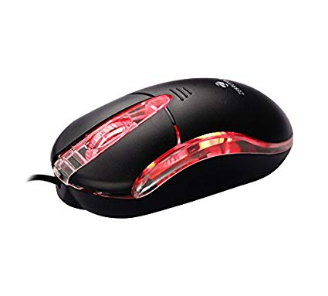
The Mouse
All modern computers have a variant
Allows users to select objects
Pointer moved by the mouse
Mechanical mouse
Rubber ball determines direction and speed
The ball often requires cleaning
Allows users to select objects
Optical mouse
Light shown onto mouse pad
Reflection determines speed and direction
Requires little maintenance

Slide 6
The Mouse
Interacting with a mouse
Actions involve pointing to an object
Clicking selects the object
Clicking and holding drags the object
Releasing an object is a drop
Right clicking activates the shortcut menu
Modern mice include a scroll wheel

Slide 7
The Mouse
Interacting with a mouse
Actions involve pointing to an object
Clicking selects the object
Clicking and holding drags the object
Releasing an object is a drop
Right clicking activates the shortcut menu
Modern mice include a scroll wheel
Benefits
Pointer positioning is fast
Menu interaction is easy
Users can draw electronically

Slide 8
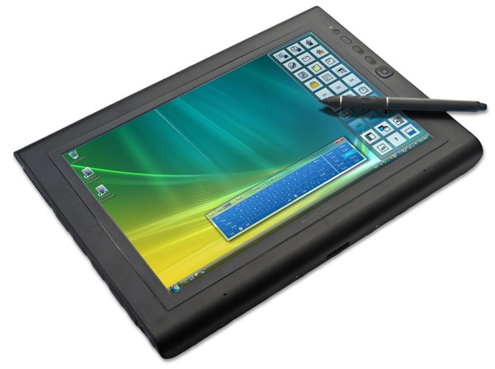
Devices for the Hand
Pen based input
Tablet PCs, PDA
Pen used to write data
Pen used as a pointer
Handwriting recognition
On screen keyboard
Touch screens
Sensors determine where finger points
Sensors create an X,Y coordinate

Slide 9
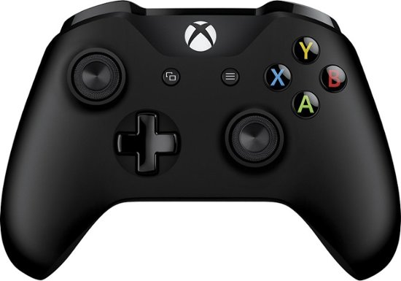
Devices for the Hand
Game controllers
Enhances gaming experience
Provide custom input to the game
Joystick
Game pad

Slide 10
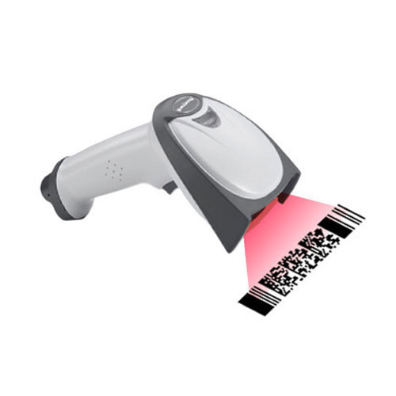
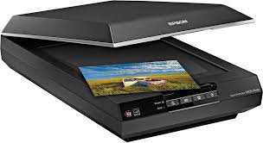
Optical Input Devices
Allows the computer to see input
Bar code readers
Converts bar codes to numbers
Computer find number in a database
Works by reflecting light
Image scanners
Converts printed media into electronic
Reflects light off of the image
Sensors read the intensity
Filters determine color depths

Slide 11
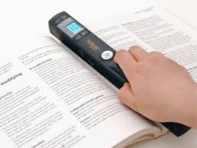
Optical Input Devices
Allows the computer to see input
Optical character recognition (OCR)
Converts scanned text into editable text
Each letter is scanned
Letters are compared to known letters
Best match is entered into document
Rarely 100% accurate

Slide 12
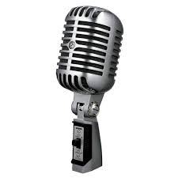
Audiovisual Input Devices
Microphones
Used to record speech
Speech recognition
Understands human speech
Allows dictation or control of computer
Matches spoken sound to known phonemes
Enters best match into document

Slide 13
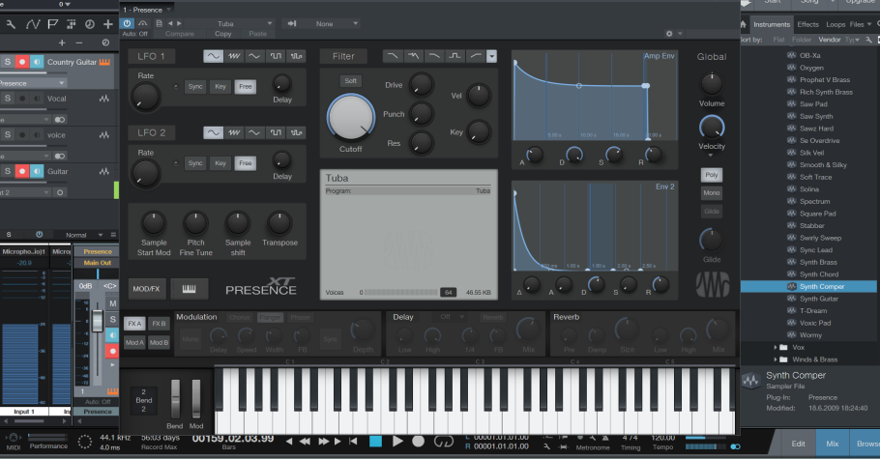
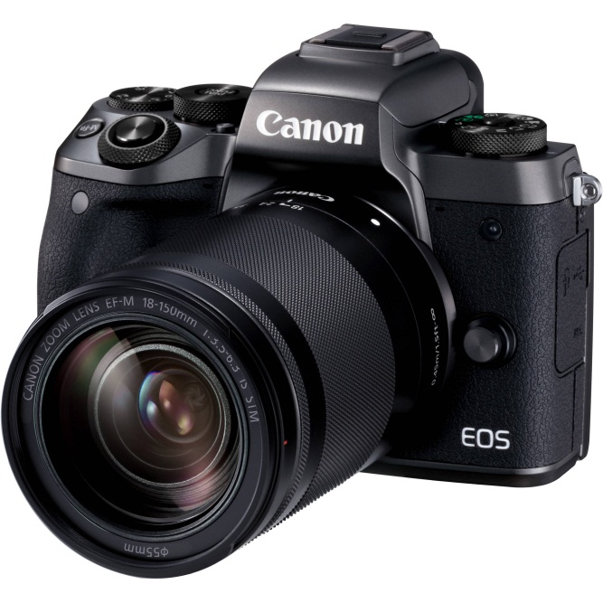
Audiovisual Input Devices
Musical Instrument Digital Interface
MIDI
Connects musical instruments to computer
Digital recording or playback of music
Musicians can produce professional results
Digital cameras
Captures images electronically
No film is needed
Image is stored as a JPG file
Memory cards store the images
Used in a variety of professions

Slide 14
Ergonomics and Input Devices
Ergonomics
Study of human and tool interaction
Concerned with physical interaction
Attempts to improve safety and comfort
Ergonomics is the process of designing or arranging workplaces', products and systems so that they fit the people who use them.

Slide 15
Ergonomics and Input Devices
Repetitive Strain Injury (RSI)
– Caused by continuous misuse of the body
– Many professions suffer from RSI
– a painful medical condition that can cause damage to the hands, wrists, upper arms, and backs, especially of
people who use computers and other forms of keyboard
Carpal Tunnel Syndrome
– Carpal tunnel is a passage in the wrist
– Holds nerves and tendons
– Prolonged keyboarding swells tendons

Slide 16
Ergonomics and Input Devices
• Office hardware suggestions
Office chairs should have
Adjustable armrests and height
Armrests
Lower back support
Desks should have
Have a keyboard tray
Keep hands at keyboard height
Place the monitor at eye level

Slide 17
Output Devices

Slide 18
Monitors
Most common output device
Connects to the video card
Categorized by color output
Monochrome
One color with black background
Grayscale
Varying degrees of gray
Color
Display 4 to 16 million colors

Slide 19
Monitors
Cathode Ray Tube (CRT)
Most common type of monitor
Electrons fired from the back
Electrons excite phosphor to glow
Phosphor is arranged in dots called pixels
Dot mask ensures proper pixel is lit
CRT color
Phosphor dots arranged in triads
Red, green, and blue dots
Three colors blend to make colors
Varying the intensity creates new colors

Slide 20
Monitors
Liquid Crystal Display (LCD)
Commonly found on laptops
Desktop versions exist
Solve the problems of CRT
Fluorescent lights provide illumination
Passive matrix LCD
Pixels arranged in a grid
Pixels are activated indirectly
Animation can be blurry
Active matrix LCD
Each pixel is activated directly
Pixels have 4 transistors
One each for red, green, blue and one for opaqueness
Animation is crisp and clean

Slide 21
Monitors
CRT drawbacks
Very large
Very heavy
Use a lot of electricity
Drawbacks to LCD
More expensive than CRT
Must sit directly in front of screen
Can be more fragile than CRT

Slide 22
Monitors and Video Cards
Monitors impacts user effectiveness
Monitors should have
Crisp text
Clear graphics
Adjustable controls
Clear edges
Size of monitor
Measured in inches
Measured diagonally
Actual size
Distance from corner to corner
Viewable size
Useable portion of the screen

Slide 23
Monitors and Video Cards
Resolution
Number of pixels on the screen
Higher number creates sharper images
Higher number creates smaller images
Refresh rate
Number of time the screen is redrawn
Modern equipment sets this automatically
Improper settings can cause eyestrain
Dot pitch
Distance between the same color dots
Ranges between .15 mm and .40 mm
Smaller creates a finer picture

Slide 24
Video Cards
Device between the CPU and monitor
Better cards result in better output
Removes burden of drawing from CPU
Have their own processor and RAM
Modern cards have up to 11 GB RAM
Capable of rendering 3D images

Slide 25
Ergonomics and Monitors
Eyestrain
Fatigue of the eyes
Steps to avoid
Choose a good monitor
Place the monitor 2 3 feet away
Center of screen below eye level
Avoid reflected light
Electronic magnetic fields (EMF)
Generated by all electronic devices
EMF may be detrimental to health
Steps to avoid
Keep the computer at arms length
Take frequent breaks
Use an LCD monitor

Slide 26
Data Projector
Replaced overhead and slide projectors
Project image onto wall or screen
LCD projectors
Most common type of projector
Small LCD screen
Very bright light
Require a darkened room
Digital Light Projectors
A series of mirrors control the display
May be used in a lighted room

Slide 27
Sound System
Integral part of the computer experience
Capable of recording and playback
Sound card
Device between the CPU and speakers
Converts digital sounds to analog
Can be connected to several devices
Modern cards support Dolby Surround Sound
Headphones and headsets
Replacement for speakers and microphones
Offer privacy
Does not annoy other people
Outside noise is not a factor
Headsets have speakers and a microphone

Slide 28
Commonly Used Printers
Impact printers
Generate output by striking the paper
Uses an inked ribbon
Non-impact printers
Use methods other than force
Tend to be quiet and fast
Dot matrix printers
Impact printer
Used to print to multi-sheet pages
Print head strikes inked ribbon
Line printers
Band printers
Speed measured in characters per second

Slide 29
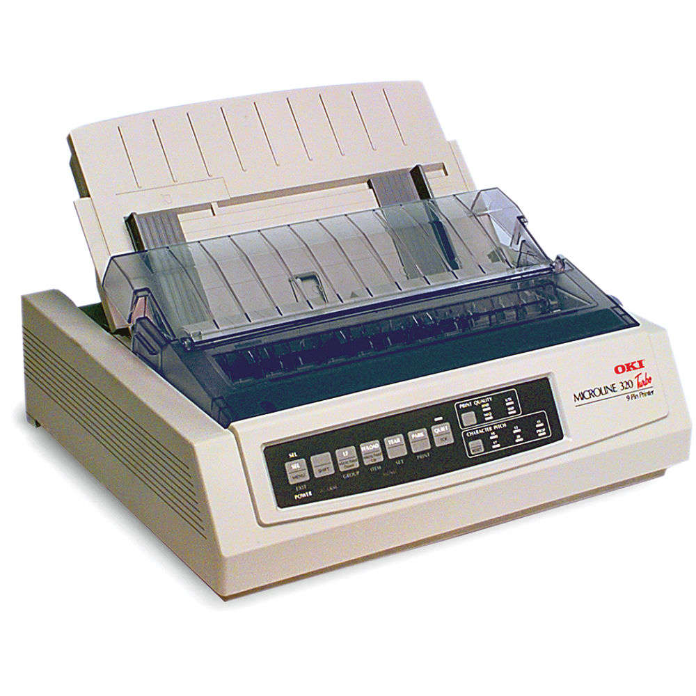
Dot Matrix Print Head

Slide 30
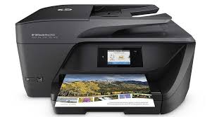
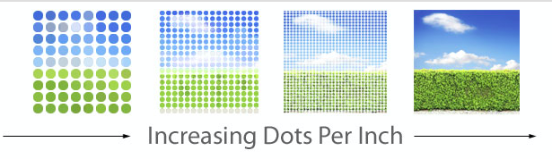
Commonly Used Printers (Inkjet printer)
Inkjet printing is a type of computer printing that recreates a digital image by propelling droplets of ink onto paper and plastic substrates

Slide 31
Commonly Used Printers
Laser printer
Non-impact printer
Produces high quality documents
Color or black and white
Print process
Laser draws text on page
Toner sticks to text
Toner melted to page
Speed measured in pages per minute
Quality expressed as dots per inch

Slide 32
Comparing Printers
Determine what you need
Determine what you can spend
Initial cost
Cost of operating
Image quality
Speed

